Slide 1

Elastic Search For Dot Net Developers
By
David Betteridge
@da_betteridge
Notes:
I’ve worked in the software industry for the past 20 years, coding in C# and using Microsoft’s SQL Server for storage
Recently we’ve been looking at other solutions such as Elastic Search in order to solve some of our performance issues.

Slide 2

Tonight
Notes:
Tonight we will be looking at Elastic Search from the point of view of a dot net developer. If this was a Java meetup then this would be a different talk!
What issues do we have with SQLServer which we like to solve
What is elastic search
How do we get started / install/query
Does it solve our problems

Slide 3
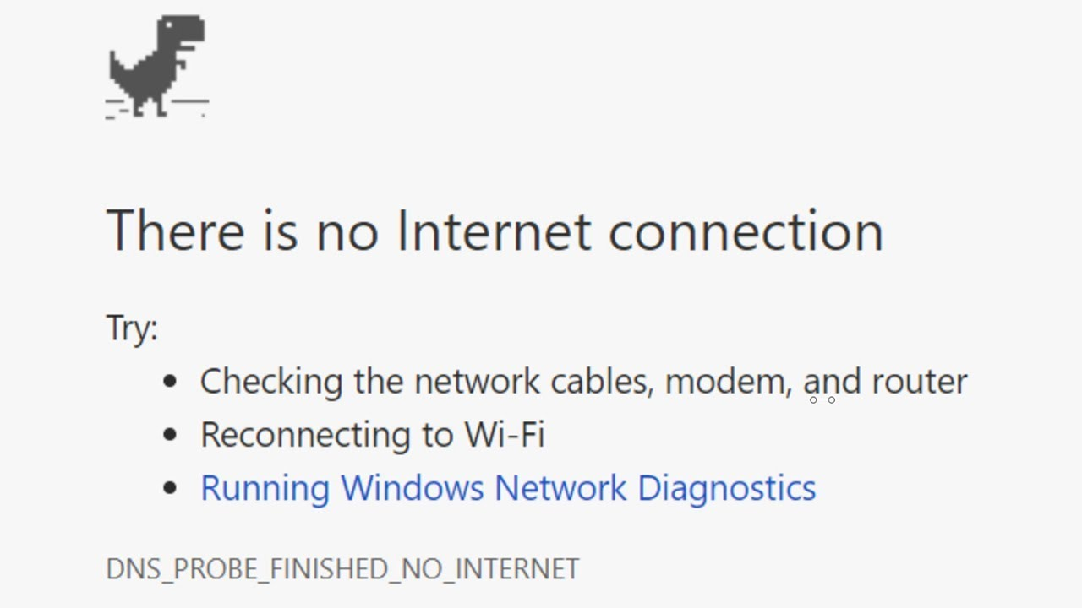


Requirement
Notes:
So you are some coding, getting stuck as usual which requires you to use google and stackoverflow to find various answers
However, then disaster strikes, you lose your internet connection
You can no longer use stack overflow.

Slide 4
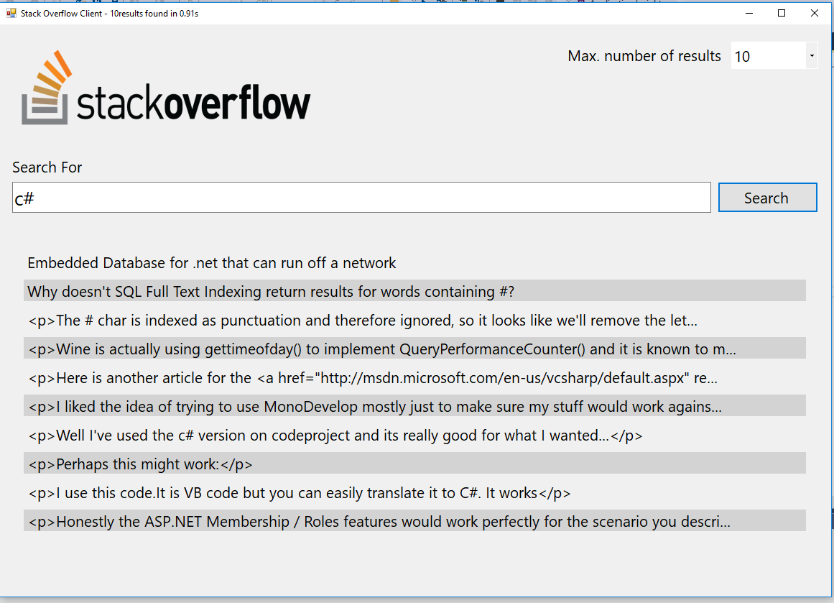
The Application
Notes:
To enable you to work offline I’ve download a SQLServer database containing 10GB of questions + answers
And written an windows form application in order to query it.
Demo application

Slide 5
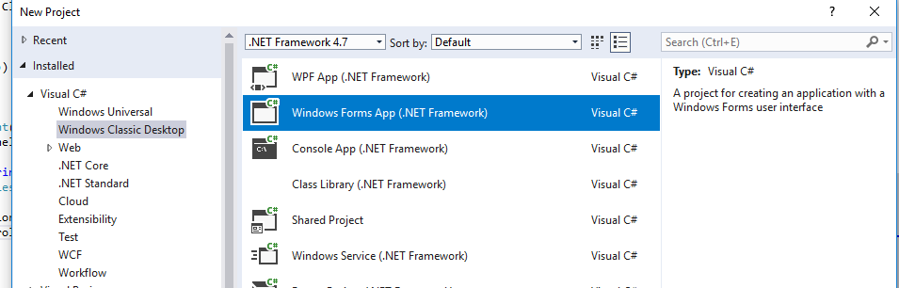
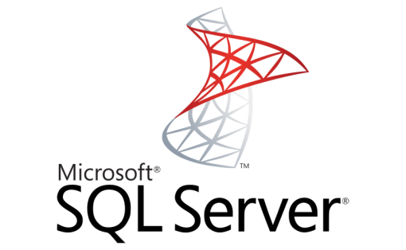
Architecture
Notes:
Look at the database in SSMS (StackOverflow2010)
Point out the size and main tables (Posts and Comments)
Our tables just have indexes on the ID
Do count(*) to get the number of rows
select rowcnt from sysindexes where OBJECT_NAME(id) = 'Posts'
select rowcnt from sysindexes where OBJECT_NAME(id) = 'Comments’
Show that without any indexes, querying the data will be very slow
select top 10 *
from dbo.Posts
where LastEditorDisplayName = 'David’
Estimated Query shows that every row will be examined (clustered index scan)
We could create indexes, but on which columns, as we might want to search by any of them.
Even then we can’t create an index on the main content field.
select top 10 *
from dbo.Posts P
where lower(P.Body) like 'c%’
We want to do a case-insensisitve search so need to convert ever thing to lower case. Also indexes can’t be used with do are doing a %wild card search
We could use full text search in SQLServer, but it’s limited in features and performance.
Finally, scale, the full stack overflow database is over 130GB, without any indexes. You can split sql server over multiple database but there are complications.

Slide 6

Problems
Notes:
So to summarise, we have three problems
The ability to be able to search across multiple fields
The ability to be able to search within a block of text
The ability to scale out across multiple machines

Slide 7
Introducing Elastic Search
Elasticsearch is an open-source, broadly-distributable, readily-scalable, enterprise-grade search engine.
Accessible through an extensive and elaborate API, Elasticsearch can power extremely fast searches that support your data discovery applications.
Notes:
Getting started
Inverted Index
Rest API
NEST API
Bulk Import
Demo adding data
Demo search for data

Slide 8

Notes:
Elastic Search

Slide 9

Notes:
Log Stash

Slide 10

Notes:
Kibana

Slide 11

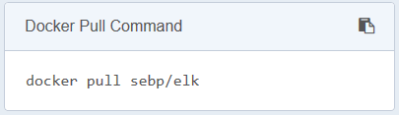
Getting Started
Notes:
This starts running
Elastic Search
Log Stash (5044)
And Kibana (5601)
We will just look at Elastic Search for the moment.
Show http://localhost:9200/
We can see the version number and basic cluster info.
Elastic Search is built on top of lucence.
Communication can be done via REST calls, for example to view the health of our 1 node cluster
http://localhost:9200/_cluster/health
Stemming etc

Slide 12
REST
Notes:
Describe index type and id
Index/type/id id is optional
Result is created, then updated
The version number also goes up

Slide 13

Elasticsearch.Net

Slide 14

NEST

Slide 15

NEST Client
ElasticSearch.Net
REST
Notes:
So to summarise
The NEST Client is most developer friendly and is built using the ElastisSearch.Net client
The ElastisSearch.Net client can do everything that the REST client can do, built from it’s specification

Slide 16
The Application Revisited
Notes:
The elastic search version

Slide 17

Kibana

Slide 18
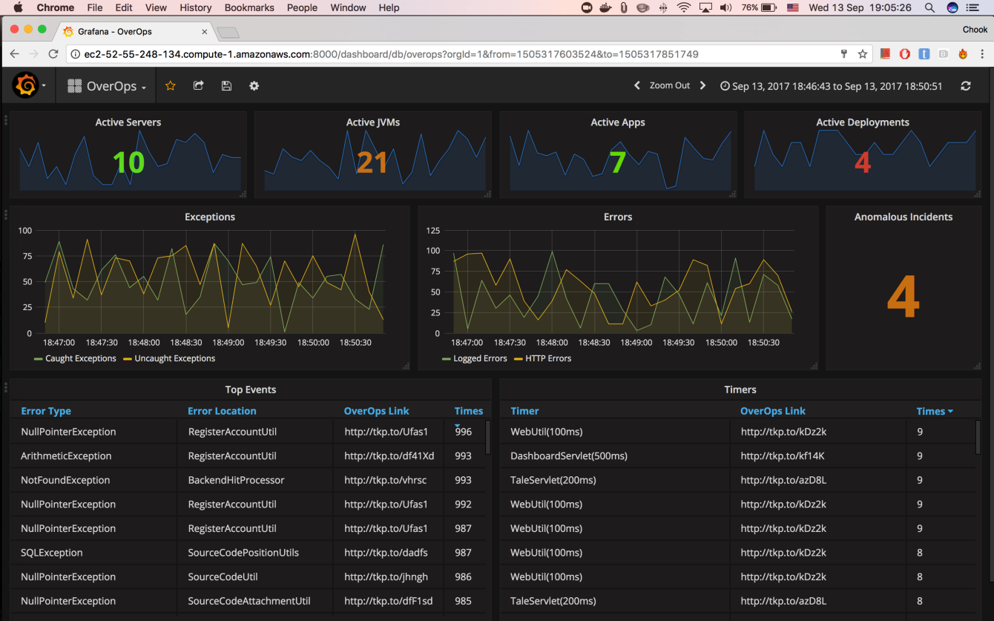
Grafana
Notes:
An alternative to Kibana is Grafana.
This allows data to be read from alternative source, and can query multiple elastic search clusters.
However as it’s more generic, I don’t find it as good for exploring data.
Grafana has decent role based security built in, Kibana needs the x-pack, which until recently you had to pay for.

Slide 19

Log Stash
Notes:
Centralize, Transform & Stash Your Data
Logstash is an open source, server-side data processing pipeline that ingests data from a multitude of sources simultaneously, transforms it, and then sends it to your favorite “stas
Requires the Java runtime – might be an issue on dotnet only servers.
Show config in iis manager
cd F:\logstash-6.2.2\bin
.\logstash -f ..\demo_conf
Load data
Show on map

Slide 20
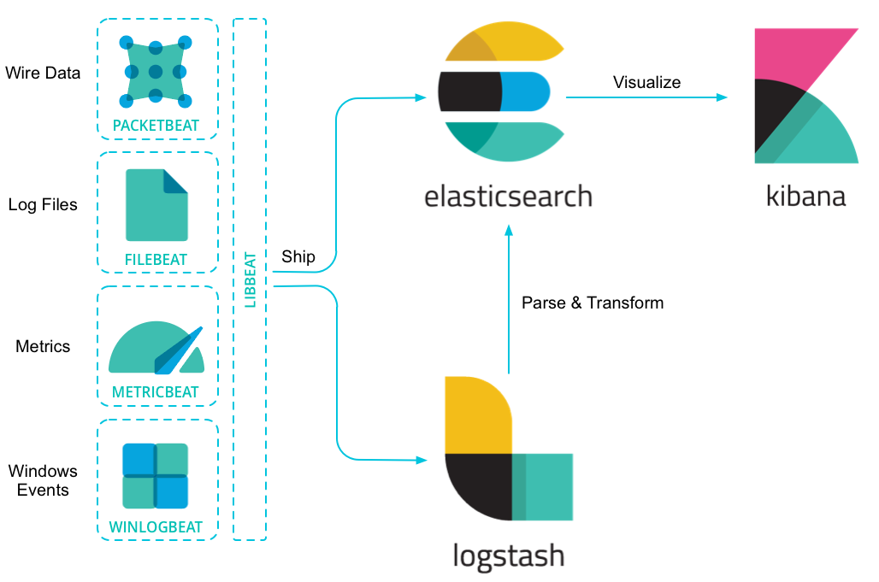
Beats
Notes:
The libbeat library is written in GoLang
Demo WinLogBeat
Cd into C:\Code\Elastic Search Talk\Software\winlogbeat-6.2.4-windows-x86_64
Show winlogbeat.yml (event logs + setup dashboard)
./winlogbeat.exe -c winlogbeat.yml
Show results in Kinaban (watch out data range)
There is an IIS beat coming soon

Slide 21

Security
Notes:
Which brings us on to security.
In the Microsoft world I was used to everything being secured by default. This isn’t the case with ELK stack.
Do you need security – well that depends on what you are using elastic search for. Backing the stackoverflow search client, then probably not. This is no different from having an internal sqlserver database.
If you are using it as a logging system, then yes. You don’t want people to be able to add/amend/delete logs.
When using Kibana, do you want everyone to see you data? You can use the Xpack to restrict what dashboards a person can see, and if they are allowed to edit them.
You could put an API gateway in front of Elastic search. So your application calls the API gateway, this verifies you are allowed to make the call, and the passes the class onto ES. You would configure ES so that it can only be called from the API gateway.

Slide 22
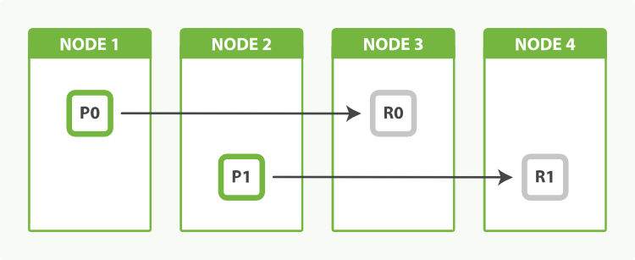
Scaling
Notes:
Nodes, Shards and replicas
Replicas can help read performance

Slide 23
Summary
We compared SQL Server to Elastic Search
Looked at various libraries to load data
Looked at some queries
Looked at some visualisation
Looked at log stash and beats
Discussed security
Discussed scaling
Questions?

